Slide 1

RRNet: Towards ReLU-Reduced Neural Network for
Two-party Computation Based Private Inference
Jiahui Zhao
Notes:
Hello everyone：
Thank you for joining me today as I introduce you to my research project, RRNet: Towards ReLU-Reduced Neural Network for Two-party Computation Based Private Inference.
As you may know, secure private inference has become a critical concern for various applications, ranging from healthcare to finance to defense. Traditional techniques for secure private inference, such as multi-party computation, have their limitations when it comes to handling deep neural networks with non-linear operators such as ReLU.
To address these challenges, we have developed RRNet, a novel approach to two-party computation-based private inference that utilizes a customized neural network architecture to reduce the computational overhead of ReLU operations. Our system enables faster and more efficient secure private inference while maintaining high accuracy.

Slide 2

ABSTRACT
Two-party computation (2PC) is promising to enable privacy-preserving deep learning (DL).
The 2PC-based privacy-preserving DL implementation comes with high comparison protocol overhead from the non-linear operators.
This work presents RRNet, a novel systematic framework that enables low latency, high energy efficiency & accuracy, and security-guaranteed 2PC-DL by integrating the hardware latency of the cryptographic building block into the neural architecture search loss function.

Slide 3
ABSTRACT
We develop a cryptographic hardware scheduler and the corresponding performance model for Field Programmable Gate Arrays (FPGA) as a case study.
The experimental results demonstrate that RRNet-A and RRNet-B achieve 63 ms and 228 ms latency on private inference on ImageNet, which are 147 and 40 times faster than the SOTA CryptGPU system, and achieve 70.54% & 78.79% accuracy and more than 1000 times higher energy efficiency.

Slide 4
Challenges
Machine-Learning-As-A-Service (MLaaS) has been an emerging solution nowadays, to provide accelerated inference for diverse applications. The current popular techniques to enable secure private inference (PI) includes multi-party computation (MPC) and homomorphic encryption (HE).
HE can only conduct shallow neural network (NN) PI and has significant encryption overhead.
MPC is good solution for deep NN but is expensive for non-linear operators such as ReLU.

Slide 5
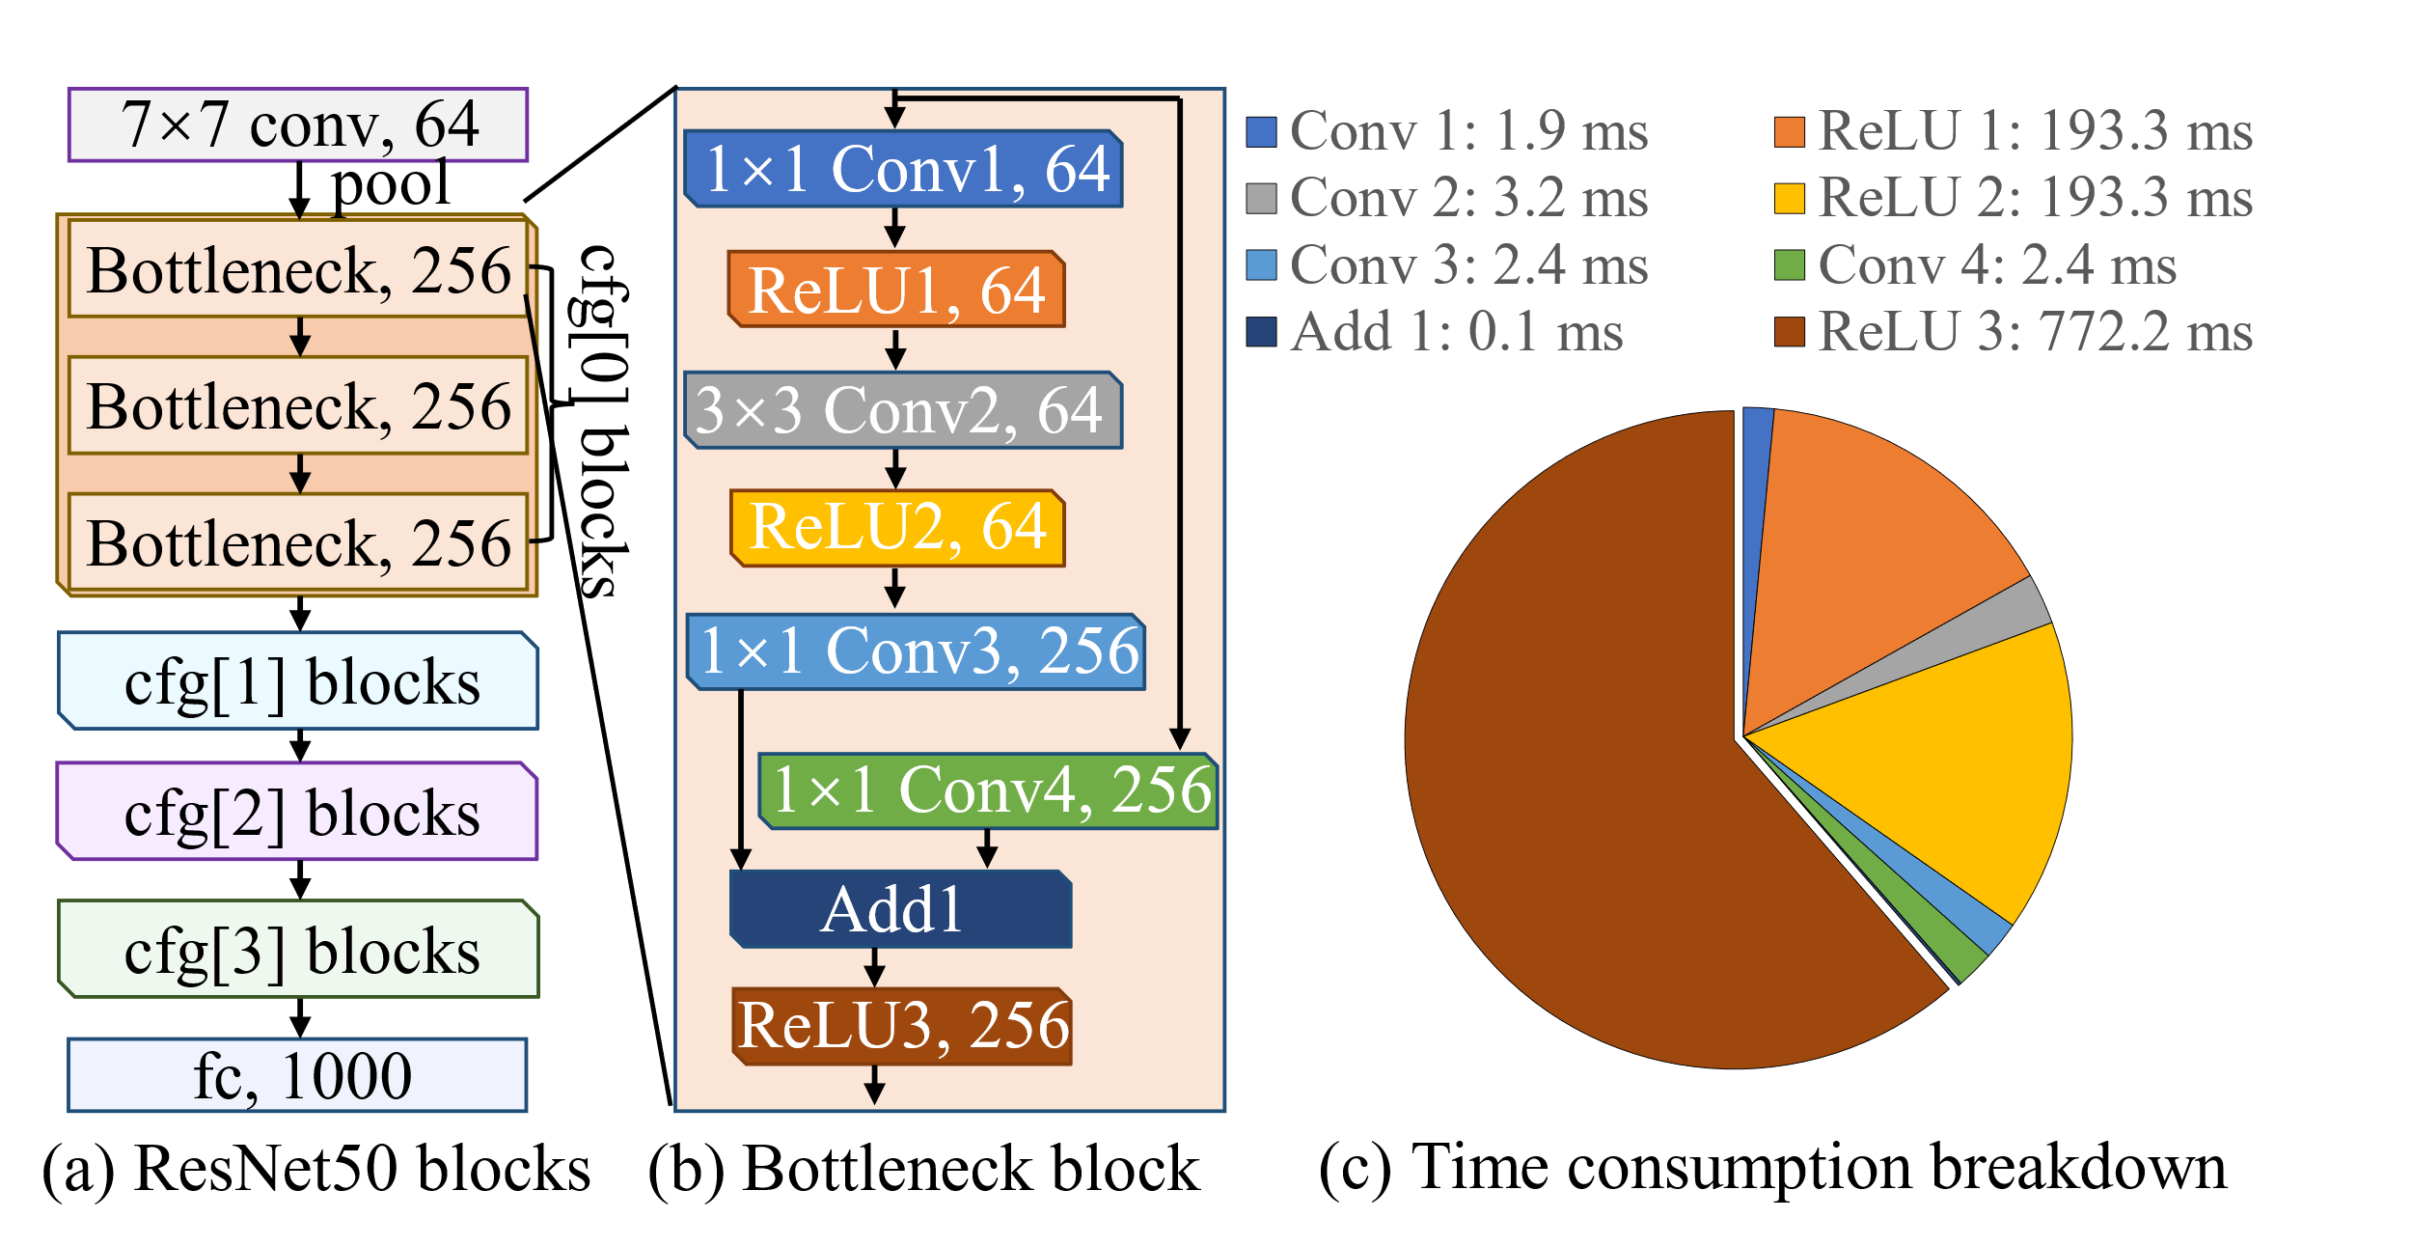
Challenges
The example above shows that the ReLU operator cost much longer evaluation latency than the Convolution operators.
To overhead challenges in MPC based PI, we need to replace ReLU with other polynomial operators, such as f(x) = wx + b or f(x) = w₂x² + w₁x + b. However, present NN architecture may not fit for such polynomial operators.
MPC based private inference overhead comparison

Slide 6
Preliminary
Overhead comparison of polynomial operator (Conv2D, MM) and non-polynomial operator (ReLU):
Multiplicative (polynomial) operator only requires single round communication, and required communication volume is small (few MBs).
Non-polynomial operator (ReLU) requires multi-party comparison, which can be realized through oblivious transfer, and the communication volume is large (GBs)

Slide 7
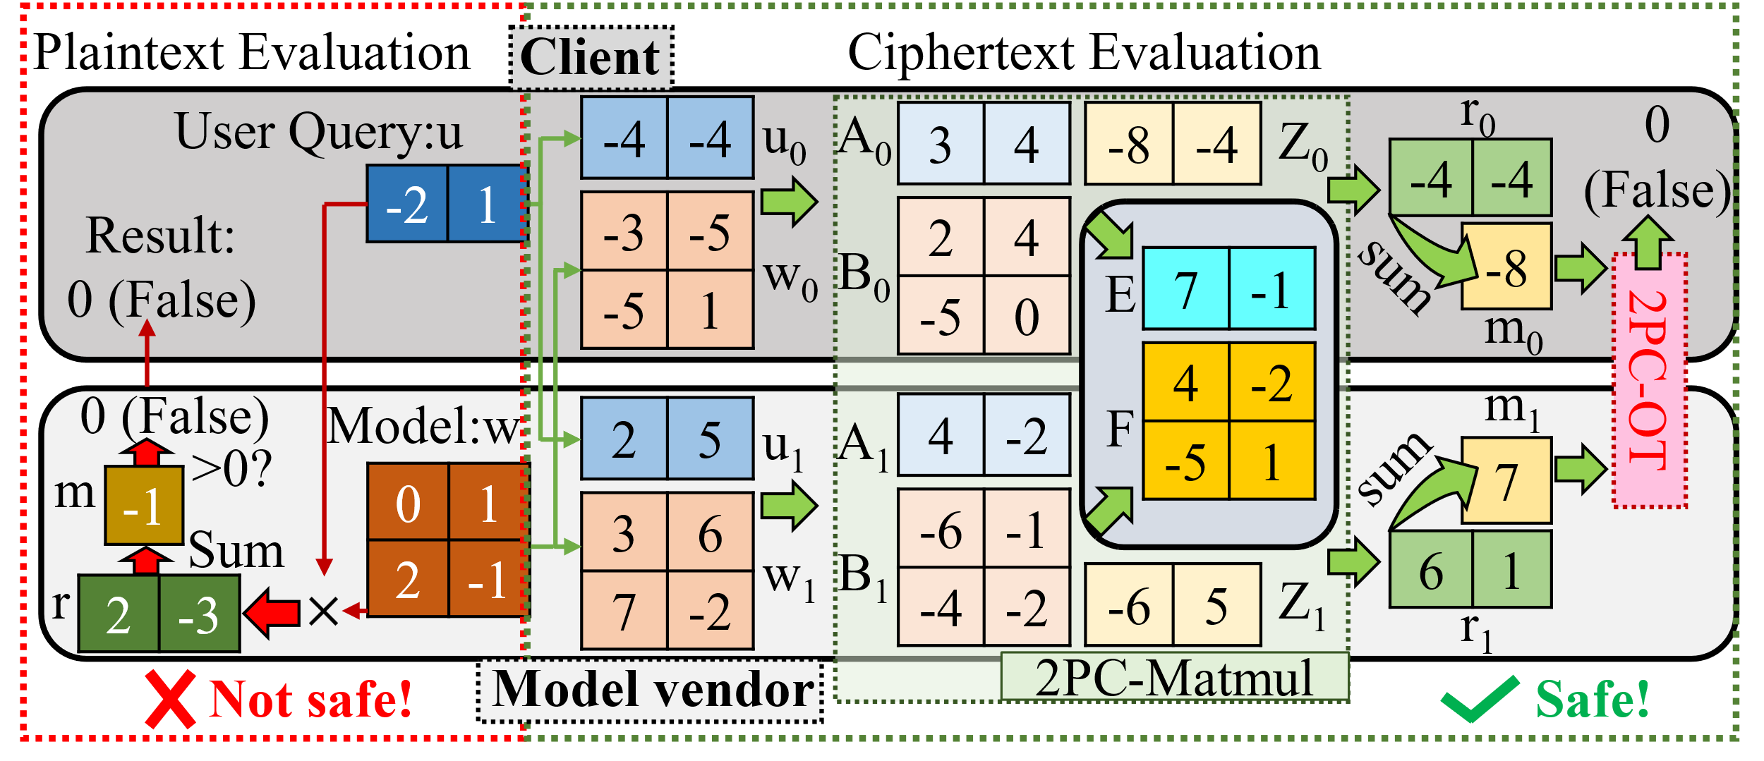
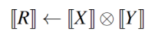
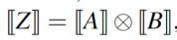
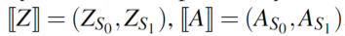
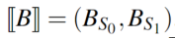
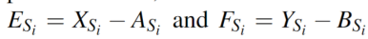
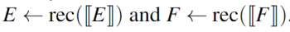
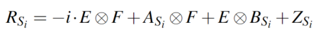
Preliminary – Multiplication in Cyphertext
Workflow of MPC based PI
Notes:
In our work, we consider the use of matrix multiplicative operations in the secret-sharing pattern, specifically R = X × Y, where × is a general multiplication such as Hadamard（哈姆达） product, matrix multiplication, and convolution. To generate（占） the required Beaver（逼维尔） triples, Z = A × B, we utilize an oblivious transfer based approach, with A and B being randomly initialized（in你手来子的）. It is important to ensure that the shapes of Z, A, and B match those of R, X, and Y, respectively, in order to align the matrix computation. Next, each party computes two intermediate matrices, E_{S_i} and F_{S_i}, separately. The intermediate shares E and F are then jointly recovered. Finally, each server $S_i$ calculates the secret-shared $R_{S_i}$ locally to get the result.

Slide 8
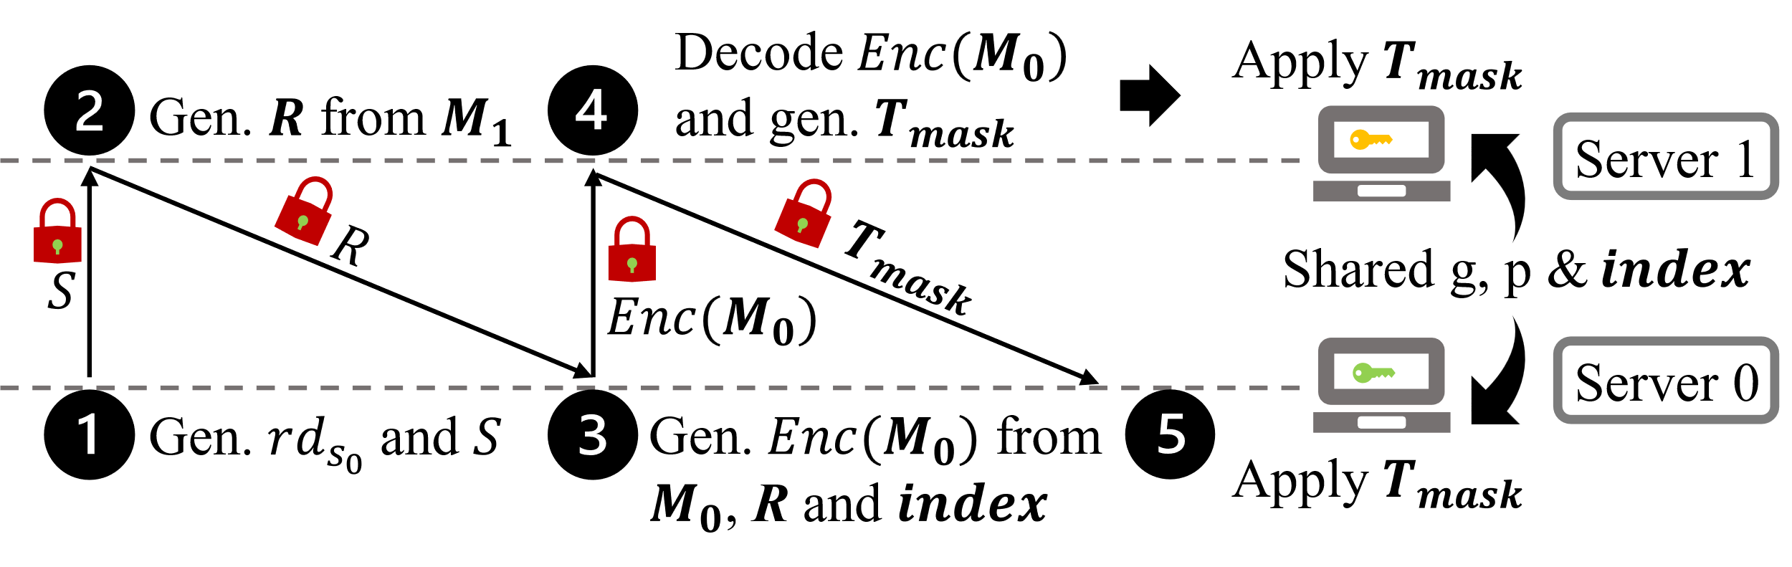
Preliminary – Comparison in Cyphertext (Crypten framework)
Oblivious transfer based non-polynomial operator workflow
Notes:
In the context of secure MPC, the 2PC comparison protocol, also known as the millionaires‘ protocol, is designed to determine which of two parties holds a larger value, without revealing the actual value to each other. We uses the same protocol as CrypTen to conduct comparison through conversion between arithmetic（鹅rose美tic） share and binary share for final evaluation. The comparison involves 5 rounds of communication between servers and is very costly in terms of communication volume.

